Slide 1
START UP PROFIT PREDICTION
Using Regression Models
Srinivasan k
Data science intern
Exposys data labs
VIRTUAL INTERNSHIP PROGRAM

Slide 2
PROBLEM STATEMENT
In the given dataset, R&D Spend, Administration Cost and Marketing Spend of 50 Companies are given along with the profit earned. The target is to prepare an ML model which can predict the profit value of a company if the value of its R&D Spend, Administration Cost and Marketing Spend are given.
Construct Different Regression algorithms
Divide the data into train set and test set
Calculate different regression metrics
Choose the best model

Slide 3
Classification, prediction and clustering
CLASSIFICATION: It is generally referred as separating data into available classes.
PREDICTION: It is generally trying to fit the data into similar roles as quick as possible.
CLUSTERING: It is generally the way to group the data when there is no label or values
available.

Slide 4
PREDICTION: REGRESSION ANALYSIS
Regression analysis, in statistical modeling, is a way of mathematically sorting out a series of variables. We use it to determine which variables have an impact and how they relate to one another.
In other words, regression analysis helps us determine which factors matter most and which we can ignore.
There are several models of regression and they can be used depending upon the data set available.

Slide 5
HOW REGRESSION ANALYSIS WORK?
It tries to determine how strongly related one dependent variable is to a series of other changing variables referred to as independent variables.
The dependent variable is the one that we focus on. In our case: Profit
Independent variables are the factors that may or may not affect the dependent variable. In our case: Research and Development Spend, Administration Cost and Marketing Spend.
Dependent receives the impact, while Independent provides (or not) the impact.

Slide 6
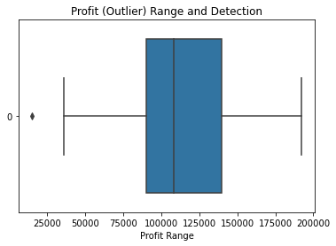
WORKING
Regression analysis helps us determine which factors really matter and their relationships. It also helps us find out what their effects are on sales figures.
Here, we use the available independent variable to predict the dependent profit value.
The profit range detected using a Box Plot.

Slide 7
REGRESSION METHODS:
There are basically five kinds of basic regression models:
Simple Linear Regression (or) Multiple Linear Regression (3 or more attributes)
Logistic Regression
Ridge Regression
Lasso Regression
Polynomial Regression

Slide 8
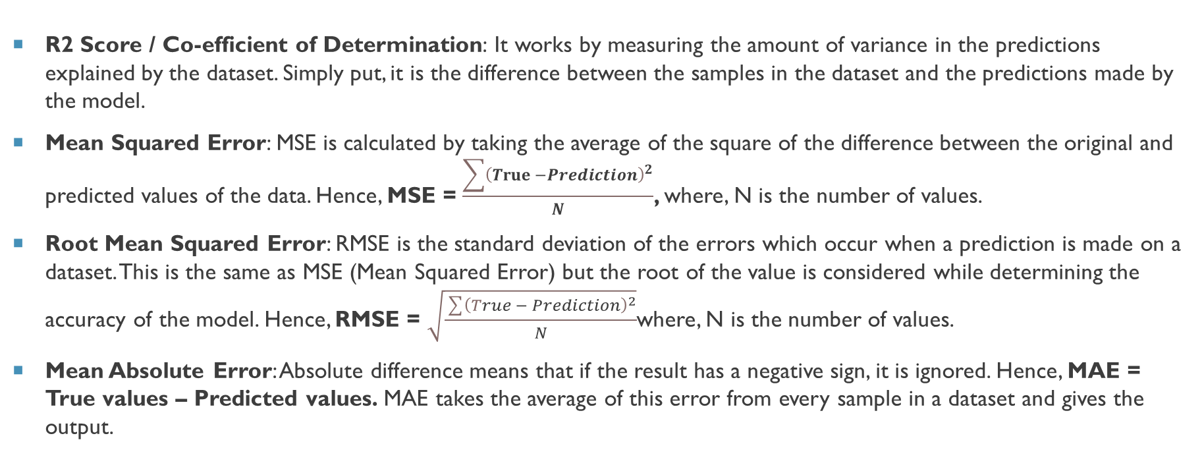
REGRESSION METRICS:
R2 Score / Co-efficient of Determination: It works by measuring the amount of variance in the predictions explained by the dataset. Simply put, it is the difference between the samples in the dataset and the predictions made by the model.
Mean Squared Error: MSE is calculated by taking the average of the square of the difference between the original and predicted values of the data. Hence, MSE = $\frac{\sum{{\left(True −Prediction\right)}^{2}}}{N}$, where, N is the number of values.
Root Mean Squared Error: RMSE is the standard deviation of the errors which occur when a prediction is made on a dataset. This is the same as MSE (Mean Squared Error) but the root of the value is considered while determining the accuracy of the model. Hence, RMSE = $\sqrt{\frac{\sum{{\left(True − Prediction\right)}^{2}}}{N}}$where, N is the number of values.
Mean Absolute Error: Absolute difference means that if the result has a negative sign, it is ignored. Hence, MAE = True values – Predicted values. MAE takes the average of this error from every sample in a dataset and gives the output.

Slide 9
THE DATA SET
https://drive.google.com/file/d/1Z7RKmScBO7n9vcDIG3Xeo853Ics4QFaF/view
It contains the Research and Development Costs, Administration Costs, Marketing Spend and the Profit accumulated.

Slide 10
THANKS

